Slide 1
Introduction to Java

Slide 2
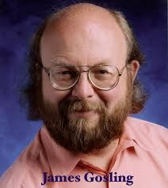
Java History
Java was originally designed for interactive television, but it was too advanced technology for the digital cable television industry at the time.
It started with a green Team (Java Team), initiate this project to develop a language for digital devices such as set-top boxes, television.
However, it is best suited for internet programming. Later, Java technology was incorporated by Netscape

Slide 3
Continuous
It was developed by James Gosling, who is known as the father of Java, in 1995, where his team members started the project in 1990s.
Initially it was designed for small, embedded system in electronic appliances like set-top boxes.
Firstly, it was called GreenTalk by James Gosling and the file extension was .gt.
After that it was called Oak and was developed as a part of the Green project.

Slide 4
Why was Java named as “Oak”?
Oak is a symbol of strength and chosen as a national tree of many countries like the U.S.A., France, Germany, Romania etc.
In 1995, Oak was renamed as “Java” because it was already a trademark by Oak Technology.

Slide 5
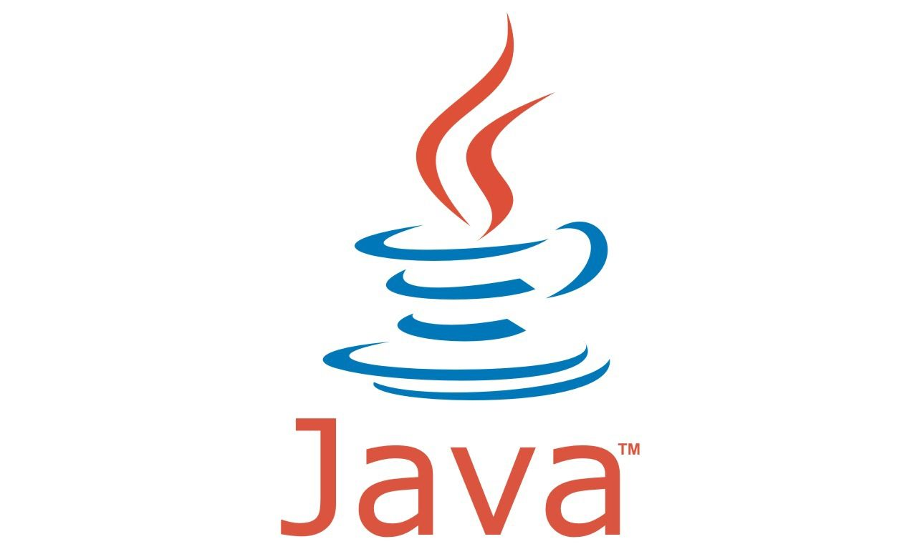
Why Java Programming named Java
Then the green team take suggestion and suggested were like “dynamic”, “revolutionary”, “Silk”, “DNA” etc. They want something that reflects the essences of the technology.
Thus, James Gosling likes Java and Silk. Since Java was so unique, most of the team members preferred Java than other names.
Java is an island in Indonesia where the first coffee was produced (called Java coffee). It is a kind of espresso bean. Java name was chosen by James Gosling while having a cup of coffee nearby his office.

Slide 6
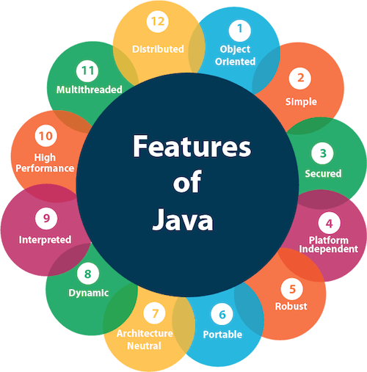
Features of Java

Slide 7
1. Simple
Java syntax is based on C++ (so easier for programmers to learn it after C++) and C.
Java has removed many complicated and rarely-used features, for example, explicit pointers, operator overloading, etc.
There is no need to remove unreferenced objects because there is an Automatic Garbage Collection in Java.

Slide 8

2. Object Oriented
Object-oriented means we organize our software as a combination of different types of objects that incorporate both data and behavior.
Object-oriented programming (OOPs) is a methodology that simplifies software development and maintenance by providing some rules.
Object
Class
Inheritance
Polymorphism
Abstraction
Encapsulation

Slide 9
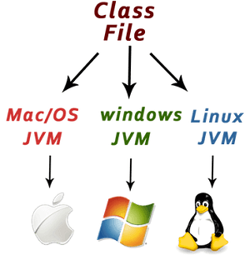
3. Platform Independent
Unlike C and C++. Java is a platform independent.

Slide 10
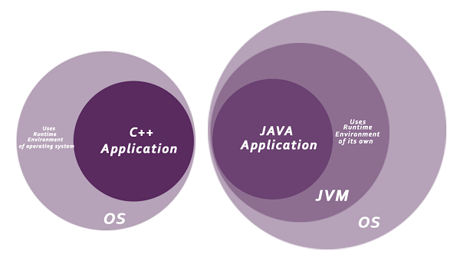
Secure
Java is best known for its security. With Java, we can develop virus free systems.
It is secure because
No explicit pointer
Java programs run inside a virtual machine sandbox.

Slide 11

Robust
The English meaning of robust is strong. Java is robust because
It uses strong memory management.
There is a lack of pointers that avoids security problems.
Java provides automatic garbage collection which runs on the Java Virtual Machine to get rid of objects which are not being used by a Java application anymore.
There are exception handling and the type checking mechanism in Java. All these points make Java robust.

Slide 12
Architecture Neutral
Java is architecture neutral because there are no implementation dependent features, for example, the size of primitive types is fixed.
In C programming, int data type occupies 2 bytes of memory for 32-bit architecture and 4 bytes of memory for 64-bit architecture. However, it occupies 4 bytes of memory for both 32 and 64-bit architectures in Java.

Slide 13
Portable
Java is portable because it facilitates you to carry the Java bytecode to any platform. It doesn't require any implementation.

Slide 14
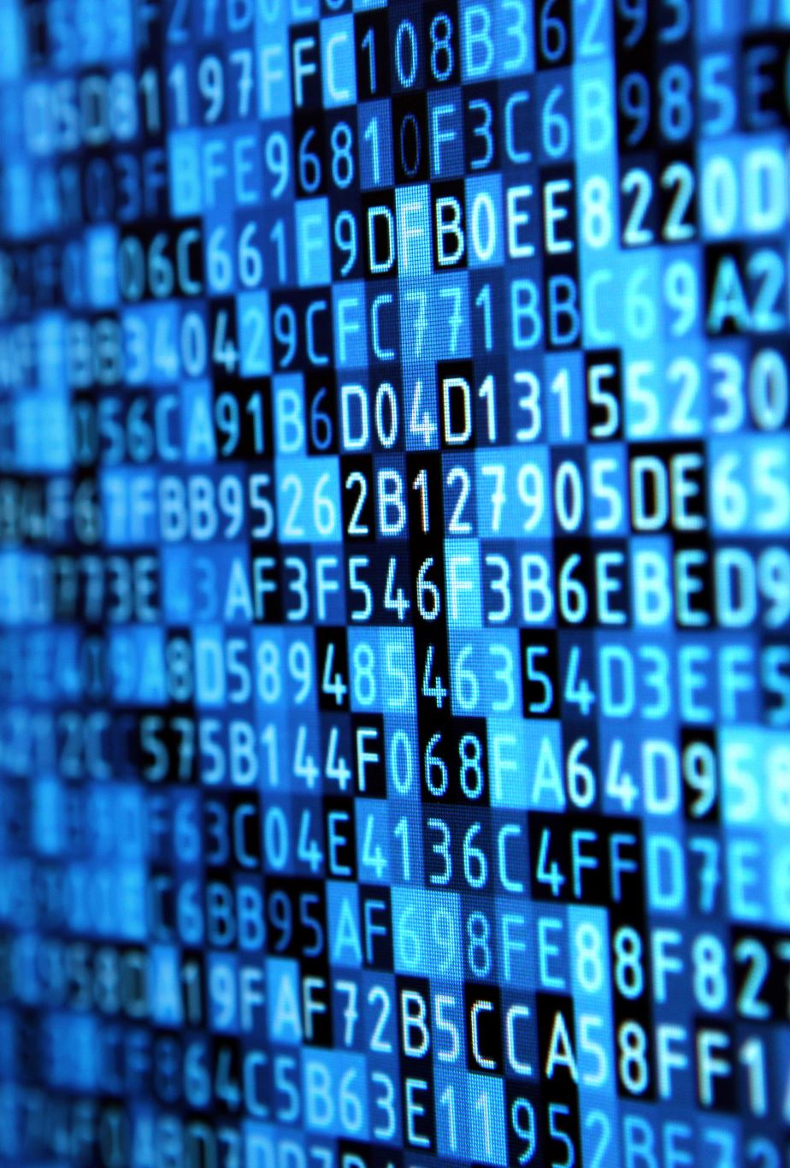
High-performance
Java is faster than other traditional interpreted programming languages because Java bytecode is "close" to native code.
It is still a little bit slower than a compiled language (e.g., C++). Java is an interpreted language that is why it is slower than compiled languages, e.g., C, C++, etc.

Slide 15
Multi-threading
We can write Java programs that deal with many tasks at once by defining multiple threads.
The main advantage of multi-threading is that it doesn't occupy memory for each thread.
It shares a common memory area. Threads are important for multi-media, Web applications, etc.

Slide 16
Comparison between Java & C
C
Java
C is a platform-dependent
It is mainly used for system programming
It was designed for programming.
It is platform independent
It is mainly used for application programming and widely used in windows-based, web-based, enterprise and mobile applications
It was designed and created as an interpreter for printing but later extended as a support network computing

Slide 17
Thank you

